Slide 1


IBM Business Automation End-to-end business automation to accelerate growth and performance, a deep dive
Jeff Goodhue Americas Business Automation Technology Leader (jgoodhue@us.ibm.com)
Greg Pollack Americas Business Automation Sales Leader (grpollac@us,.ibm.com)
Version 1.3 2022-03-23
Notes:
The purpose of this slide is to identify the content owners of this presentation as well as the revision information.
Please delete this slide before presenting and use the next slide for your client presentation.
Note: version history below, please select View, Notes Page for proper alignment
Version History
Version Date Who Slide # & Title Description Description
====== ======= ==== ================================ =================================
V1.0 01/15/21 TE Initial creation Initial creation
V1.1 01/26/22 TY 23 – Document Processing – the solution Updated speaker notes
V1.2 02/01/22 JG 9, 12, 33 Updated speaker notes/format
V1.3 03/23/22 TY Title slides Add title slide for client presentation
Capability slides (10, 13, 16, 19, 21, 28) Updated layout of the capability area slides
Updated to layout to IBM Master 2020

Slide 2
Opportunities for automation are everywhere
Companies that effectively apply intelligent automation across the enterprise expect to outshine peers in profitability, revenue growth, and efficiency over the next 3 years
Reduce customer service disruptions
Digitize processes to maintain business continuity
Approve operations tickets and exceptions
Identify gaps in operations workers
Speed employee onboarding
Improve management of IT service requests
Empower LOBs through low-code tooling
Reduce time from procure to pay
Speed order to cash
Automate KYC regulatory compliance
Quickly identify fraudulent transactions
Notes:
Businesses across the globe are grappling with automating their business processes. Embracing AI in decision-making results in significant time savings as decisions are made in real time, especially in those areas where the volume of transactions is distinctly high. Businesses should start thinking ahead too. They need a plan to introduce digital customer onboarding. Developing a digital identity framework with an identity accreditation process built around digital customer onboarding planning will make them more competitive.
Paper-based processes must be digitized and automated. This requires automating and streamlining processes. Implementing accelerators such as Robotic Process Automation (RPA), digital signatures, and analytics will help. As businesses move toward digitization and automated decision-making, it’s important to ascertain the thresholds for risk tolerance and the maximum risk appetite a business would like to take.
It’s quite simple; companies that apply intelligent automation across all parts of their business are expected to outshine those that don’t. There are opportunities across all functions of business.
--=== COACHING NOTES -- DELETE BELOW THIS LINE ==--
PURPOSE: Get the client to think about opportunities for automation they may not have thought about before
COACH: Seller should do some research on the client’s competition. Who are they? What makes then "leaders"? What makes them "laggers”?
PROBING QUESTION: Where do you see the biggest opportunities for you right now? How do they align with those of your competitors?
COACH: If these claims do not resonate with your Client, probe deeper to find out how their business model differs from their competitors
COACH: Ask you your client for THEIR definition of AI.
SELLER: “Artificial Intelligence is one of those overused terms. What does AI mean to you?”
--=== DELETE ABOVE THIS LINE ==--
SOURCE: IBM Institute for Business Value—Automation and the future of work, Published 2020
Acronyms:
LOB: Line of business
KYC: Know Your Customers
RPA: Robotic Process Automation
AI: Artificial Intelligence

Slide 3
There are gaps in the path to success
3 pillars of Digital Transformation
Digitize
Analyze and Optimize
Act
Business data is inaccessible and siloed preventing a complete view of customers and hindering compliance initiatives
Performance gaps caused by manual systems prevent efficiency and lack of reliable insights prevents operational visibility
Execution on key initiatives is slowed because of the lack of the right tools or the right skills and resources to develop them
Notes:
While tech-savvy digital leaders are seeing increased business performance, the majority are challenged with starting and scaling digital initiatives. Why is this happening?
Business data is either hidden in manual documents, multiple systems, or not in the correct formats for easy actionability. For example, product usage data for clients that sits in multiple systems can’t be easily pulled into one view – making it difficult to effectively cross-sell opportunities at the right point in time. Or, a new regulation comes that requires a different approach to managing personal identification information (PII), Clients are not able to track down all the places that PII lives in their systems – putting their business at risk for hefty fines, or worse.
Performance gaps in certain business processes cause compounding issues. For example, customer service reps that must manually enter data into multiple systems in order to approve applications and this causes delays to customers while being error prone. And without the ability to track key metrics across the company, it’s difficult to pinpoint where those companies should focus their attention first to have the greatest impact on operations as a whole.
Execution on key initiatives, particularly the ability for line of business (LOBs) to quickly respond to changing demands, is slowed because they don’t have the right tools available that they can use to quickly make changes themselves. The LOB must rely on shared IT resources or outsourced resources with projects that take several cycles because of unclear requirements due to lack of subject matter expertise (SME) involvement in the process.
--=== COACHING NOTES -- DELETE BELOW THIS LINE ==--
COACHING POINTS: The purpose of this slide is to introduce the 3 pillars associated with Digital Transformation
Business Data
Performance gaps and Insights
Execute
--=== DELETE ABOVE THIS LINE ==--
Acronyms:
PII: Personal Identification Information
LOB: Line Of Business
SME: Subject Matter Expert

Slide 4

Addressing performance gaps with business automation
3 pillars of Digital Transformation
Digitize
Data capture (Scanning, OCR, etc.)
Content management
Process modeling (as is)
Process mining
Decision Modeling
Robotic process automation
Analyze and Optimize
Operational intelligence
Process mining
Process modeling (to be)
Act
Robotic process automation
Workflow
Decision management
Data capture
Content management
Notes:
Let’s talk about how the Digital Automation journey addresses business challenges.
As we look at the 3 main strategic focus area we see:
Operational excellence – When a Client has optimized their own internal processes resulting in shorter turnaround, lowers cost, and other efficiencies. For example, manufacturing in China is an example of operational excellence based on the production cost.
Product leadership – When a Client has developed a product, solution, or offering which stands above any/all the competitors. Samsung would be an example of Product leadership in the home appliance space.
Customer intimacy – When a Client has gained trust and a strong rapport with their customers. And, for example, Neflix has successfully developed a strong understanding of their consumers and their customer value the recommendations that Netflix makes based on their viewing patters.
Some clients strive to pursue one or more of these area of focus.
Now, let’s look at an end-to-end Digital Automation journey in support of these areas of focus.
We can break down this journey into 3 buckets:
The need to digitize information (i.e., Digitize Column)
The need to analyze and optimize the digitized information (i.e., Analyze and Optimize column)
The ability to act/react to the information processed (i.e., Act column)
Each one of these buckets is in turn comprised of a set of capabilities. Think of them as entry points.
IBM Cloud Pak for Business Automation delivers across all these capabilities. With regards to the end-to-end digital automation journey, not every client can or should implement all of these capabilities. IBM provides the flexibility to allow clients to pick and choose where to start on that journey and what capabilities they want to implement at any given point along that journey.
--=== COACHING NOTES -- DELETE BELOW THIS LINE ==--
PURPOSE: The purpose of this slide is to introduce the Digital Automation journey
POTENTIAL QUESTIONS/OBJECTIONS YOU MAY HEAR FROM CLIENT:
”This sounds too complex. We are a small/mid size company. We do not have the need for such complex solution”
"Your statement suggests a dependency. So if any/all are NOT met does it mean I will not be able to start a Digital Transformation?"
COACH: Here you need to downplay the Cloud Pak and focus more on the individual capabilities.
SELLER: Don’t look at these capabilities as being an “all or none” deployment. IBM gives you the flexibility to start small and add later as your business grows and/or changes. Let’s go back to my previous statement around the “end-to-end”. In no way am I suggesting that every client should or will be implementing all these capabilities. The point here is that our offering allow you to “pick and choose” where to start and how many capabilities to undertake at any given time.
--=== DELETE ABOVE THIS LINE ==--
Acronyms:
OCR: Optical Character Recognition

Slide 5
Capabilities of IBM Business Automation Complete, integrated solution for digitizing and automating work
Notes:
Now let’s look at how our Business Automation works in action.

Slide 6











Capabilities of IBM Business Automation
Automation
accelerators
Process mining and modeling
RPA and digital labor
Operational intelligence
Core automation
Document processing
Workflow automation
Decision management
Content
services
AI and machine learning
Process mining and modeling
Discover frequency, rework, duration, and cost from real data
Generate process models
Analyze impact on KPIs
Simulate future processes
RPA and digital labor
Perform repetitive tasks
Act on data extracted from unstructured documents
Automate systems that do not have APIs
Core automation
Content services
Document processing
Workflow automation
Decision management
Low-code applications
AI and operational intelligence
Apply AI to operational data
Classify and understand content
Prioritize tasks
Make predictive decisions
Build intelligent chatbots
6
Notes:
Let’s look at a business automation model.
Process mining and modeling enables clients to:
Understand existing processes and task flows so they can identify areas for improvement
Analyze and simulate future processes to help them get started with new automations
Adding Robotic Process Automation (RPA) allows clients to:
Perform repetitive tasks to free up employees so they can focus on higher value work
Combine RPA with intelligent capture so they can ingest unstructured documents and act on the data
Make automation even more accessible with targeted, purpose-built chatbots that are directly connected to the automation
By adding Core automation, clients can:
Digitize documents, including documents on paper so they’re not dependent on being in the same building as a room full of file cabinets
Manage work, including business processes and cases
Automate decisions based on business policies
Build low-code applications that use these automation capabilities
Monitor and report on these applications so they can understand the outcomes and continually improve
By adding AI and machine learning, clients can:
Understand unstructured documents without needing to know the format of the documents in advance
Prioritize the tasks that workers perform, using machine learning to match the right people to the tasks they’re best at
Automate predictive decisions, by combining business rules with predictive analytics
Use intelligent chatbots to put a conversational interface in front of their business automation projects
Use the data generated by all these capabilities to gain unique insights into how to make automation more effective

Slide 7



IBM Business Automation: Automation accelerators
Process mining and modeling
Understand and analyze your processes
Robotic Process Automation
Use bots to automate routine human tasks
Operational intelligence
Gain insights with built-in AI
Understand existing process and task flows to find the most important improvement candidates
Analyze impact on key performance indicators (KPIs) to engineer process improvements with rigor
Simulate future processes using “what-if” analysis to optimize the business response
Automate repetitive tasks to reduce cycle time and focus human work on higher value activities
Eliminate copy-and-paste and data-entry errors to reduce rework and delays
Achieve many of the benefits of technical integration without IT involvement
Capture, consolidate, and analyze data generated by operational systems to easily identify important problems and opportunities
Amplify the power of core automation by leveraging the power of operational data
Apply AI and machine learning to discover performance improvement insights and actions
Notes:
The Cloud Pak for Business Automation provides additional capabilities we refer to as our automation accelerators.
Process mining and modeling is used to understand and analyze your processes in order to help identify areas for automation
RPA and digital labor is used to automate routine activities in order to free employees for higher value work
Operational intelligence is used to gain operational insights in order to adjust for improvement

Slide 8
Capabilities of IBM Business Automation
Automation
accelerators
Process mining and modeling
RPA and digital labor
Operational intelligence
Core automation
Document processing
Workflow automation
Decision management
Content
services
AI and machine learning
Process mining and modeling
Discover frequency, rework, duration, and cost from real data
Generate process models
Analyze impact on KPIs
Simulate future processes
RPA and digital labor
Perform repetitive tasks
Act on data extracted from unstructured documents
Automate systems that do not have APIs
Core automation
Content services
Document processing
Workflow automation
Decision management
Low-code applications
AI and operational intelligence
Apply AI to operational data
Classify and understand content
Prioritize tasks
Make predictive decisions
Build intelligent chatbots
8
Notes:
Let’s dive deeper into Process mining and modeling.

Slide 9

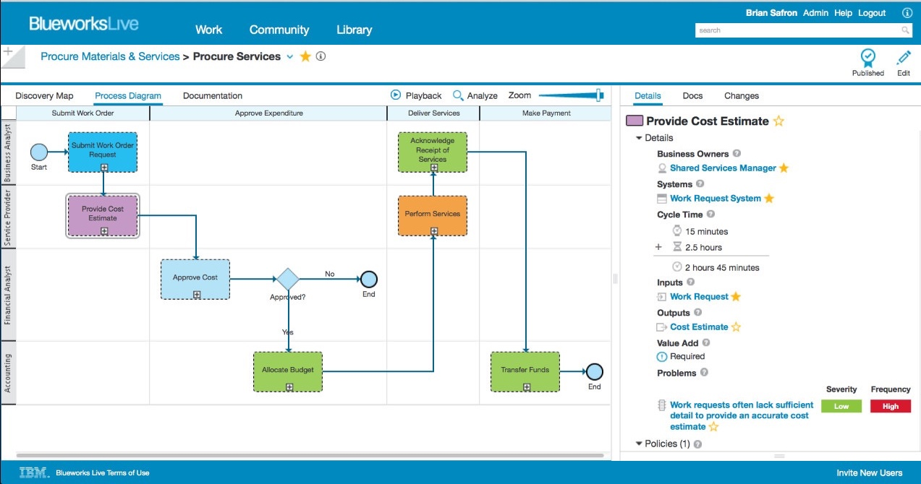
Collaborate across teams
Process modeling
Work collaboratively across teams and departments to model business processes without the need to meet in person or on a firm schedule
Central, shared repository is always up to date with all changes in real time, eliminating the time to search for the latest version and potential for rework
Improve processes and identify efficiencies from a big-picture view of business processes
Runs in the cloud and accessed through a web browser—just log in and go—non-disruptive to your IT organization
Document and analyze an extensive set of process details with out-of-the-box and customizable properties
Improved team productivity in a remote working context
Notes:
IBM Blueworks Live is cloud-based software that gives you a dedicated, collaborative environment to build and improve business processes through process mapping. Business analysts, subject matter experts, and any other designated editors or contributors can easily work together through an intuitive web interface to document and analyze processes to make them more efficient. And because it’s in the cloud, there’s nothing to download. It’s accessible anywhere and provides a single location for all business processes to live.
Easy & intuitive for both business & IT users: We believe that business users know best how the process currently works and where it needs fixing, so with BWL we aim to get business users excited about process improvement by engaging them directly in the information capture, analysis & proposed improvement.
To that end, BWL:
Introduces process modeling in a simple, intuitive way
Automatically generates process and decision diagrams; layout is automatic and fast
Enables users to get started quickly with no training required
All work is automatically saved and backed up
Runs in the cloud and accessed through a web browser - nothing to install or set up, just log in and go
Videos:
Process made simple: https://www.youtube.com/watch?v=fRY-onXjMdw
IBM Blueworks Live: https://youtu.be/GG_noUKYun4

Slide 10















The customer view of the organization and processes
Process mining—the real processes derived from data
Automatically generate process models from production systems without the need for extensive 'as-is' discovery workshops
Identify the most frequent activities, rework and variants that are good candidates for RPA or Workflow
Visualize highest wait-time and duration that show potential bottlenecks to automatically help identify opportunities for cycle time reduction
Highlight costly activities based on resources and operations
Simulate process changes and assess attractive candidates without modifying current processes
Sources
Mobile
IBM Process Mining
Desktop
Data storage
Knowledge
base
Cloud
Notes:
Nowadays, enterprises are executing their business processes across several different stakeholders, such as enterprise resource planning (ERP) systems, customer resource management (CRM) systems, customer care applications, and ticketing systems, among others.
When business processes don’t belong to one single application, it can become very difficult for a business user to have a clear, end-to-end view of the process, and process users often feel like the process is too complex and difficult to be managed or understood.
<CLICK>
Process Mining can automatically streamline the end-to-end process, starting from the available data of the applications that the process is running on.
In the grey box in the center of this slide, the business activities and processes are shown together with their stakeholders/sources (such as desktop applications, mobile applications, and cloud applications). Thanks to IBM Process Mining, this digital footprint is extracted, uploaded into the platform (Data Storage), and then a knowledge base is created using Process Mining’s algorithms.

Slide 11
Capabilities of IBM Business Automation
Automation
accelerators
Process mining and modeling
RPA and digital labor
Operational intelligence
Core automation
Document processing
Workflow automation
Decision management
Content
services
AI and machine learning
Process mining and modeling
Discover frequency, rework, duration, and cost from real data
Generate process models
Analyze impact on KPIs
Simulate future processes
RPA and digital labor
Perform repetitive tasks
Act on data extracted from unstructured documents
Automate systems that do not have APIs
Core automation
Content services
Document processing
Workflow automation
Decision management
Low-code applications
AI and operational intelligence
Apply AI to operational data
Classify and understand content
Prioritize tasks
Make predictive decisions
Build intelligent chatbots
11
Notes:
Next, we’ll focus on how Robotic Process Automation (RPA) is used to put digital labor into action.

Slide 12




Easily build bots to automate repetitive tasks
Robotic Process Automation
1. Record
a. Record user screen interactions to automatically replace manual system interactions with bots
AND
b. Assemble bot scripts from hundreds of pre-built commands to reduce the learning curve and accelerate time to value
2. Test
Test automations directly from the RPA Studio to simplify bot integration governance and reduce the time required for bot creation
3. Run and Manage
Manage bots from a central repository to enforce versioning and scale intelligent bot workload management
Rapidly automate repetitive tasks without requiring development skills
Notes:
Our Robotic Process Automation (RPA) is a low-code solution that enables you to easily build bots with low-code editors.
For example, you can:
Record user interactions to automatically generate bot scripts
Assemble bot scripts from a rich collection of prebuilt commands
Test automations directly from the bot studio

Slide 13
Capabilities of IBM Business Automation
Automation
accelerators
Process mining and modeling
RPA and digital labor
Operational intelligence
Core automation
Document processing
Workflow automation
Decision management
Content
services
AI and machine learning
Process mining and modeling
Discover frequency, rework, duration, and cost from real data
Generate process models
Analyze impact on KPIs
Simulate future processes
RPA and digital labor
Perform repetitive tasks
Act on data extracted from unstructured documents
Automate systems that do not have APIs
Core automation
Content services
Document processing
Workflow automation
Decision management
Low-code applications
AI and operational intelligence
Apply AI to operational data
Classify and understand content
Prioritize tasks
Make predictive decisions
Build intelligent chatbots
13
Notes:
Next, we’ll review IBM’s core automation capabilities.

Slide 14

Content services
Quickly search, preview, and view content across the enterprise, including information captured from paper documents
Reduce turnaround times by streamlining content management processes and delivering critical content where it is needed most
Automates the records management lifecycle process, helping to ensure best practices and reducing user-related errors
How it works
Find content with full-text and property search templates in addition to searching across repositories
View, share, and annotate documents with granular access and viewing controls
Utilize APIs and webhooks to integrate into enterprise applications
Integrations with Microsoft Office 365, Salesforce, and Enterprise Video Streaming
Automates the review process and can retain and destroy records according to records and information management policy
Outcomes
Save time and create visibility across the enterprise
Secure document access no matter the viewer
Confidently and accurately manage the lifecycle of records
Notes:
Content is unstructured or semi-structured information that can include documents, text, images, audio and video.
Content services enable users to securely manage the full lifecycle of content.
We have an enterprise-class content solution that provides flexible, reliable and secure content services. We have powerful search capabilities and enable federation across content repositories. We provide enterprise-grade security, privacy, information governance and records management. And in addition to sharing content within a company, we also enable secure sharing of content with external users who are outside the organization.
Intuitive:
Configurable and customizable to meet the needs of the business
Easily search, browse, view and collaborate on content to increase productivity
Extensible with low-code developer tools to embed content in business applications
Intelligent – easily integrate with AI-powered capabilities to:
Extract key business data from unstructured content to drive downstream applications and workflows
Automatically classify documents for efficient management and governance
Integrated:
Increase productivity by allowing users to stay within their mission critical applications while working with content
Natively connect to line of business applications like Microsoft Office & Teams, Salesforce, SAP, and more
Manage and govern all content in one place, reducing content duplication and sprawl
Flexible
Deploy on Red Hat OpenShift or any Cloud Native Computing Foundation (CNCF) certified cloud and easily upgrade with a modern containerized architecture
On-premises and SaaS options
Flexible storage options to reduce costs
Flexible database, identity provider, key management to reduce costs
Utilize APIs and webhooks for integration to enterprise applications

Slide 15
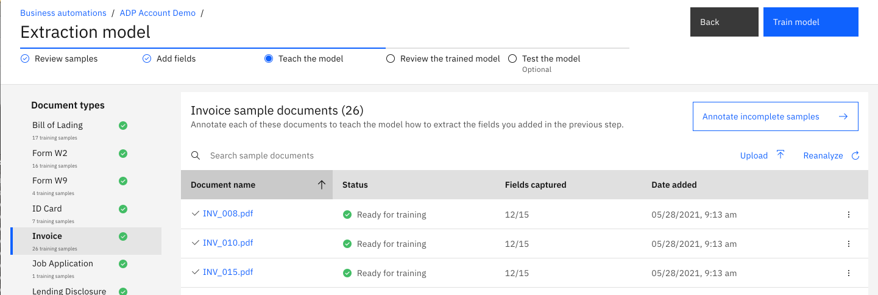
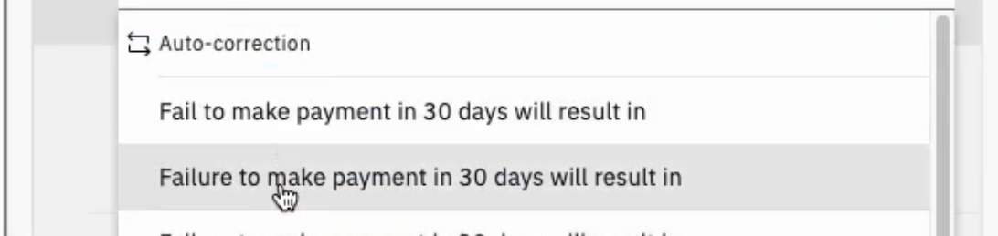
Document processing
A no-code set-up experience means that you can build the document processing applications you need without a data scientist
Extract data from structured, semi-structured, and unstructured documents
Automatically detect and correct data that has been extracted incorrectly or should be enriched
How it works
Create a document processing project and flow with a visual, step-by-step click-through approach to building applications
Jump-start the document training process by reading common fields like, “Customer Address,” or, “Account Number,” or directly reading PDF form definitions
The AI is also smart enough to handle documents it hasn’t encountered before, since it doesn’t rely on the location of fields in documents to get the information it needs
Out-of-the-box way to invoke workflows, decisions and other automation services from document processing low-code applications
Outcomes
Set-up to deployment won’t take months to complete
Easily customize a template that is relevant to your documents and scenario with consistent low-code user interface design skills from across the solution
Faster customer response times or time-to-quote by reducing manual processing and saving cost in staffing
Extract data from forms, statements, & unstructured documents
Determine whether a document has been signed or a box has been checked
Automatic data correction and suggestion of alternative data values
Notes:
With document processing, a no-code design tool is used for setting up data extraction which means you don’t need a data scientist or someone from engineering to set up your document processing applications. Using our intuitive and easy to use tooling which shows step-by-step flow, anyone can set up document processing apps so you can extract data from structured, semi-structured as well as unstructured documents. Document processing can also automatically detect and correct data that may be incorrect or should be refined without manual human intervention.
As you can see in the screenshots, document processing designer shows step by step flow on what needs to happen next to set up your applications. Business users create a document processing project to manage the flow and control access from other business automation projects. If implementing other project types, such as workflows or decisions, the project management and even some of the editing skills are shared across the Cloud Pak for Business Automation platform.
With document processing providing out of the box Machine Learning (ML) model, your training process can be accelerated as common fields can be read automatically and fields in PDF form definitions can be directly read. Even if the document type has not been seen before, our AI is smart enough to extract some data automatically as we provide AI-powered extraction instead of location-based template approach.
This means your set-up to deployment time is significantly reduced by using our document processing designer for setting up the design time and application designer templates for easily building and customizing the UI. With automatic document classification and data extraction in our no code environment, you can significantly reduce the manual human processing as humans will only need to look at data that falls below a certain threshold. With the ability to train your documents as you go, the efficiency of the solution improves every time it is used. Human in the loop is still there when needed, but skilled workers are increasingly released from these tasks, and become more active on where their skills are actually needed.
Acronyms:
ML = Machine Learning
--=== COACHING NOTES -- DELETE BELOW THIS LINE ==--
PURPOSE: The purpose of this slide is to introduce how most businesses are traditionally handling “Document Processing”
POTENTIAL QUESTIONS/OBJECTION YOU MAY HEAR FROM CLIENT: “But don’t we have to continuously manage the applications to adapt to new types of documents?”
SELLER SUGGESTED ANSWER/RESPONSE:
This is why AI is so important to address these evolving changes. The more you use this solution, the more it learns, and the better it is to adapt without having to develop new applications.
AI doesn’t look for sections in your document, it’s looking for information. It has the ability of understanding the document and extract what is relevant.
POTENTIAL QUESTIONS/OBJECTION YOU MAY HEAR FROM CLIENT: “Is the Machine Learning / Deep Learning done locally or on the cloud?”
SELLER SUGGESTED ANSWER/RESPONSE:
This solution can be hosted on your own cloud as a Kubernetes container. So all the processing is done locally, which means resource allocations are dedicated to your own environment.
OPTIONAL POINTS:
Speaker – List some of the examples below to make it feel more real to the audience.
Paper and digital images of checks that require verification
A PDF vendor invoice that comes into your accounting department’s email; Roughly two-thirds of all businesses issue PDF invoices via email, but less than 20% structured e-invoices. (https://compacer.com/wp-content/uploads/2019/05/Billentis_Report_compacer_single-sponsor.pdf p.28)
Census data released by the government that has demographic information about customers
Company social media feed that customers interact with, such as with questions, comments, and sentiments.
A product photo that gets associated with an order;
A bar code that is assigned to an item in your warehouse;
A doctor treating a patient needs more than a patient's written records--she might also require x-rays, MRIs, and other types of imagery;
A police officer wants to be able to call up a photo of a possible suspect, as well as the suspect's driving record; and
A surveyor mapping a section of land needs more than his own measurements; he combines this data with satellite and topographical imagery that enhances his work.
--=== DELETE ABOVE THIS LINE ==--

Slide 16
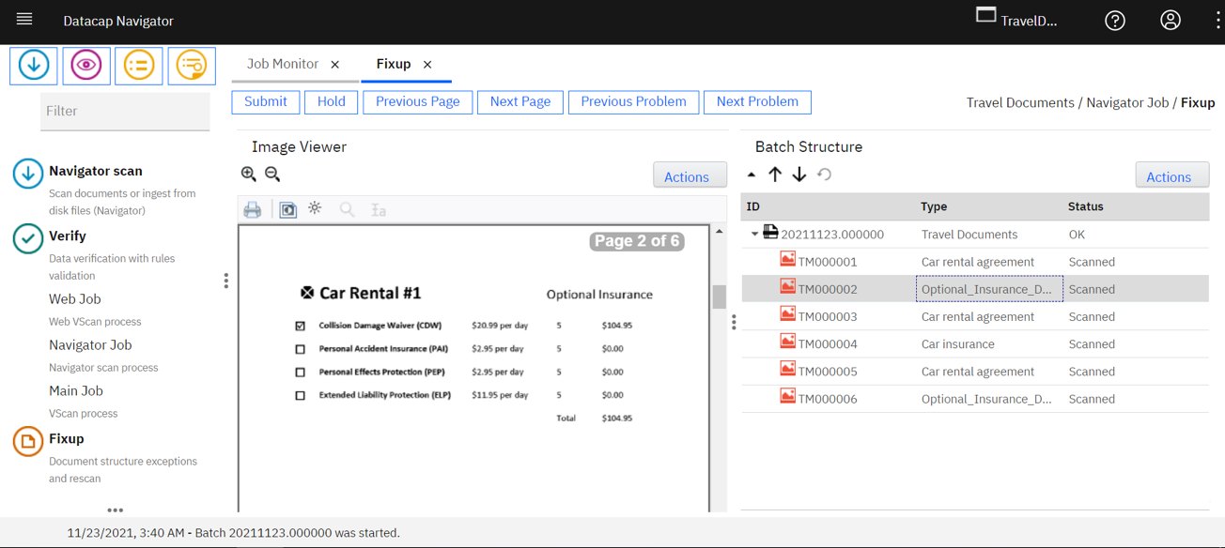
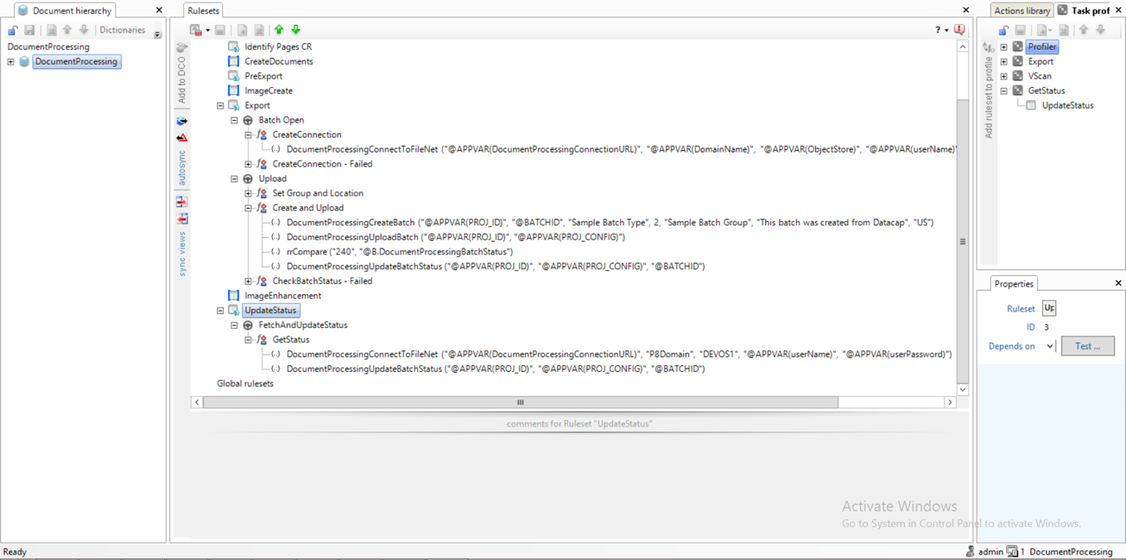
Document processing
Highly customizable processing of handwriting and 50+ languages
Ingest documents from multiple channels, using multiple methods
Document separation (splitting / joining documents together) and custom export options
How it works
Extract data from zoned fields (documents with a lot of checkboxes or complex lists)
Extract information from complex / line-item tables
External data lookup and validation
Outcomes
Eliminate inaccessible, lost, or misfiled documents
Eliminate idle time in business processes
Improve customer response times
Cost savings in staffing
Notes:
With document processing, you have best of breed, traditional capture solutions.
Highly adaptable rules-based document processing, which offers configuration of capture workflows and applications using a simple point-and-click interface to speed deployment.
Supports multichannel input from scanners, faxes, emails, digital files such as PDF, and images from applications and mobile devices.
It even enables documents to be redacted automatically based on the role of the requester to block out information according to a user's specifications
--=== COACHING NOTES -- DELETE BELOW THIS LINE ==--
PURPOSE: The purpose of this slide is to introduce how most businesses are traditionally handling “Document Processing”
PROBING QUESTION: "Specific to your business, how are you currently processing unstructured documents, and from what types of sources?”
POTENTIAL ANSWER YOU MAY HEAR FROM CLIENT: “Through various channels, such as email attachments, Fax, or sent by courier from various branches”
POTENTIAL QUESTIONS/OBJECTION YOU MAY HEAR FROM CLIENT: “Does this solution require a lot of skill to set up?”
SELLER SUGGESTED ANSWER/RESPONSE:
This solutions has decades of enhancements to accommodate even the most demanding use cases. Though that certainly requires a certain level of skill, most of our clients are able to develop on their own, or access a wide array of partners that have experience with this solution.
OPTIONAL POINTS:
Speaker – List some of the examples below to make it feel more real to the audience.
Paper and digital images of checks that require verification
A PDF vendor invoice that comes into your accounting department’s email; Roughly two-thirds of all businesses issue PDF invoices via email, but less than 20% structured e-invoices. (https://compacer.com/wp-content/uploads/2019/05/Billentis_Report_compacer_single-sponsor.pdf p.28)
Census data released by the government that has demographic information about customers
Company social media feed that customers interact with, such as with questions, comments, and sentiments.
A product photo that gets associated with an order;
A bar code that is assigned to an item in your warehouse;
A doctor treating a patient needs more than a patient's written records--she might also require x-rays, MRIs, and other types of imagery;
A police officer wants to be able to call up a photo of a possible suspect, as well as the suspect's driving record; and
A surveyor mapping a section of land needs more than his own measurements; he combines this data with satellite and topographical imagery that enhances his work.
--=== DELETE ABOVE THIS LINE ==--

Slide 17
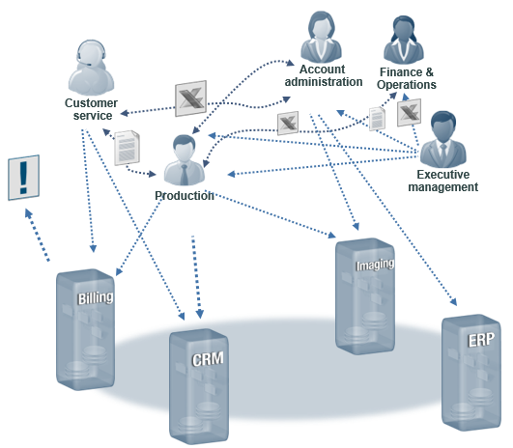
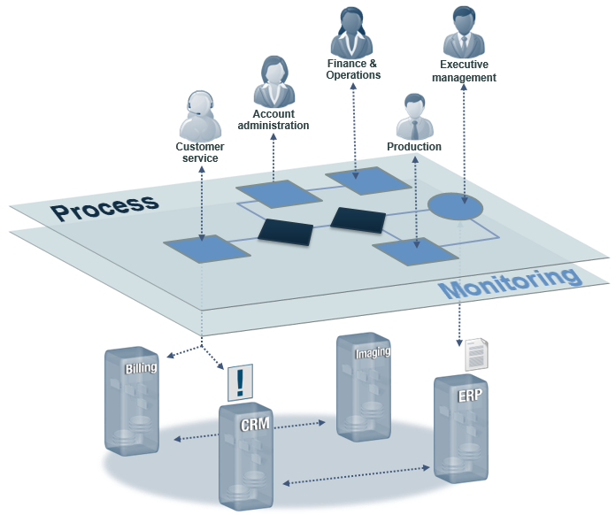
Workflow automation
Manual work
Automated processes
Replace ad-hoc chaotic processes or inefficient system(s) too expensive to maintain.
Unstructured tasks and communication
Inefficient working environment spans systems
Incomplete or inaccurate data flow between systems
Lack of control over system and business events
Poor Visibility Into operations performance
Paper-based document routing
Automatically prioritizes and routes work
Guides users through decisions
Leverages existing systems and data
Manages digitized document content
Responds to business events and initiate's action
Real-time visibility and process control
Notes:
Process Automation or Workflow manages the coordination of IT and human resources to complete an end-to-end process. For example, using workflow to automate a Loan application process can significantly reduce cycle-time resulting improved customer satisfaction, lower rate of abandonment, and lower costs.
Why’s automating processes important? Quite simply, Automation simplifies how businesses operate.
AI accelerates innovation by making every process more intelligent. Combining the two will make all information-centric jobs more productive and release USD 134 billion in labor value in 2022.
The IBM Institute for Business value estimates that automation supported by AI will generate billions of dollars in labor value in 2022. And 80% of AI and automation early adopters expect to significantly outperform their competitors, because the ultimate benefit automation delivers, supported by AI, is a smarter way to work that results in scalable revenue growth.
Acronyms:
AI: Artificial Intelligence

Slide 18
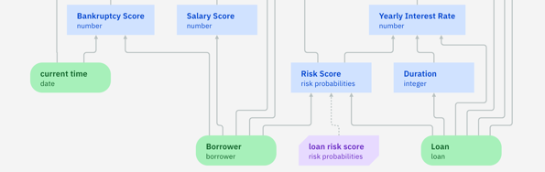
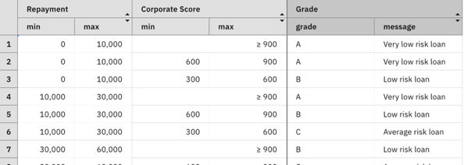
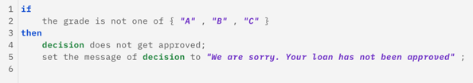
Decision management
The business logic of policies is externalized and managed by domain experts
Business logic can be updated and put in service in minutes
AI is applied to make effective and personalized decisions
How it works
Business logic is specified by business experts through intelligible decision diagrams, decision tables, business rules
Decisions can be augmented with predictions from machine learning model trained with historical data
Decisions are directly executable from applications
Outcomes
Business logic is accessible, easy to understand, consistent, auditable
Updating decision services takes minutes, not months
Each decision is tailored individually by machine learning predictions
Application code requires less frequent updates
Decision diagrams, with machine learning
Decision tables
Business rules
Notes:
With IBM decision management, the business logic and policies are no longer buried into applications. Logic is externalized and the business experts are in control. Experts can define or update business logic directly, without any help from IT.
If we take the previous example, business experts will define the logic to approve or reject a loan application. In turn, software developers will not implement how and why a loan is approved. Rather, they will invoke an external decision that will tell them if and why the loan request is approved. If the business criteria to approve a loan needs to change, the application will remain the same.
There are a lot of benefits with this approach:
Business logic is accessible, easy to understand, consistent, auditable.
Updating decision services takes minutes, not months.
Application code, without business logic, is much simpler for IT, and requires less frequent updates
Several examples of rule artifacts are depicted here:
Decision diagrams are an intuitive way to model business logic in a to- down fashion. In this screenshot the blue boxes represent decisions and can be broken down into sub-decision. The green ovals represent input data that help drive that decision. In more sophisticated diagrams, users can leverage predictive models such as scores seen here as a purple node to help augment the decision.
One of the most common forms of authoring rules is a decision table which is a familiar way to capture many rules with similar conditions and actions in a single artifact. In a decision table, some columns represent conditions, and some columns represent actions. In a decision table, every row is a rule.
When a business logic is unique, representing that business rule with natural language “IF…THEN” logic is a great way to ensure it is clear and concise.
--=== COACHING NOTES -- DELETE BELOW THIS LINE ==--
COACHING POINTS: The purpose of this slide is to introduce how a business expert could take ownership of business logic and business decisions.
PROBING QUESTION: "Specific to your business, how often do you implement new business logic? How often do you need to update existing business decisions?”
POTENTIAL ANSWER YOU MAY HEAR FROM CLIENT:
“Every x months”
“Every time regulation is changed”
“Every time we update our offerings”,
“Every time we see new fraud patterns that needs to be detected and addressed”, etc.
COACH: If your Client answers the above question with an unusual large timeframe, you may want to shift the focus to other areas like: compliance/auditability etc
POTENTIAL QUESTIONS/OBJECTION YOU MAY HEAR FROM CLIENT: “Do you really think business users can own/control such decisions?”
SELLER SUGGESTED ANSWER/RESPONSE: “Business experts are those who know and define such logic. They are the ones specialized in compliance, pricing, fraud, etc. Also, our tooling is specifically dedicated to this kind of users, where they can focus on defining and exercising the logic. For example, decision tables are very simple to use for business users. Business rules look like natural language. Etc.”.
--=== DELETE ABOVE THIS LINE ==--

Slide 19
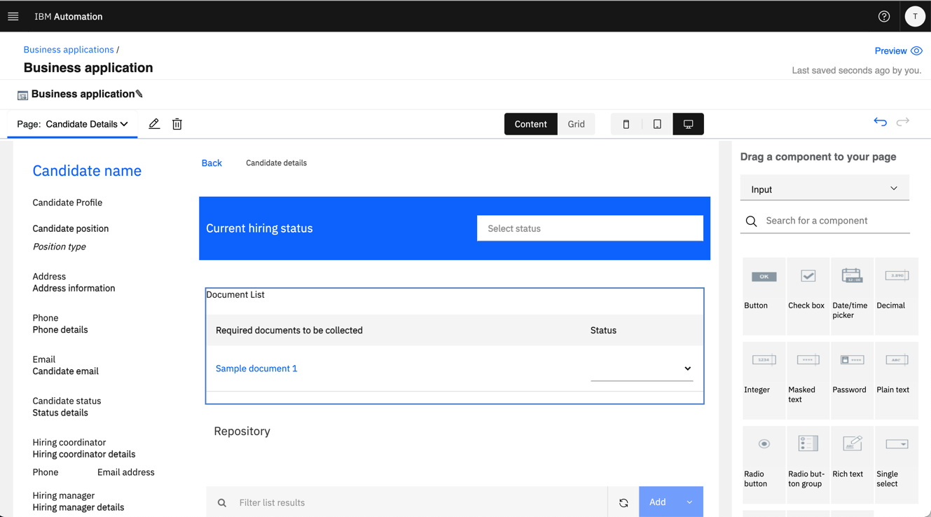
Low-code applications
A visual approach to building applications using drag-and-drop components
Low-code tools enable business users and developers to create applications without having to write code
How it works
Rich palette of out-of-the-box controls to drag and drop into your app
Add automation services for workflow, decisions, content, and document processing with the same drag and drop simplicity
Toolkits and templates accelerate development and reuse by business users’ teams
Outcomes
Create and deliver automation applications in a fraction of the time it takes with traditional methods
Inject speed, agility, and innovation into your application building
Application design environment with drag-and-drop palette
IBM Automation / © 2021 IBM Corporation
Notes:
The following are critical benefits of low-code.
Speed: In today’s digital world, a transformation is needed. Low-code development removes complexity from building great, modern business apps. And reduced complexity means smoother sailing. With these low-code benefits, organizations are better equipped to quickly adapt and respond to fast-changing business conditions.
Agility: Operating at digital speed means creating the app capabilities users require to function smoothly across multiple devices. For example, accessing data, collaboration tools, and apps should be equally viable on smartphones and desktop PCs.
Innovation: The speed and development simplicity of low-code enables junior developers and tech enthusiasts without a strong background to build apps as if they were full-stack developers. Just as importantly, it empowers skilled developers to work more efficiently, so they can focus on more complex, less mundane aspects of programming. This way, companies of any size can maximize their existing resources and deliver the solutions their business requires to stay competitive.
Cloud Pak for Business Automation provides a no code editor allowing you to rapidly create, test and deploy business applications.
Business Automation Studio comes with a set of predefined skills to also create content or decisions services as well.
You can rapidly use these services within the business applications you are creating in Application designer and then rapidly deliver new automation solutions.

Slide 20

Capabilities of IBM Business Automation
Automation
accelerators
Process mining and modeling
RPA and digital labor
Operational intelligence
Core automation
Document processing
Workflow automation
Decision management
Content
services
AI and machine learning
Process mining and modeling
Discover frequency, rework, duration, and cost from real data
Generate process models
Analyze impact on KPIs
Simulate future processes
RPA and digital labor
Perform repetitive tasks
Act on data extracted from unstructured documents
Automate systems that do not have APIs
Core automation
Content services
Document processing
Workflow automation
Decision management
Low-code applications
AI and operational intelligence
Apply AI to operational data
Classify and understand content
Prioritize tasks
Make predictive decisions
Build intelligent chatbots
20
Notes:
Now, we’ll examine some specific areas where we have infused AI and machine learning into our automations.

Slide 21

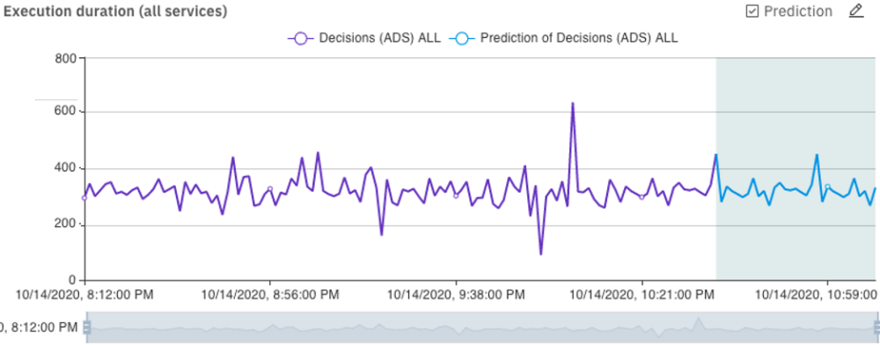
Apply AI to operational data
Derive insights from data
Feed pre-curated operational data into a data lake for integrated reporting and analysis
Enables data scientists to use operational data to:
Get insight into process execution for improvement candidates
Understand worker efficiency to help plan capacity and smooth demand
Provide recommendations and predictions based on AI models
AI prediction
Display KPI forecast predictions based on historical data
Leverage your data to gain future insights and adapt your business proactively
Notes:
Let’s talk about how to use operational intelligence to apply AI to operational data.
We pre-curate your operational data and use it to populate a data lake. That data lake can then be used by data scientists to apply AI and machine learning into your business operations.
Here we are using machine learning to predict the evolutions of a specific key performance indicator that can give you ideas about what is likely to happen to your business in the future.
Stay tuned here, because this will be a major topic in the next frontier of automation. By learning from this operational data, you’ll gain insights that can greatly increase the productivity of your employees and make your business operations significantly more effective. This is a growing area that will differentiate the quality of your business operations in the future.

Slide 22
Classify and understand content
Automatically understand and categorize documents based on the contents to improve usage strategies
Leverage deep learning to understand relationships between document labels and values and speed extraction design
Extract meaning from text (e.g., emails, contracts) with Watson Knowledge Studio to increase the universe of potential automation use cases
No-code design tool for training the system to classify documents and identify data fields
Reduced human actions to classify and understand documents
Notes:
Intelligent classification and extraction provides a way to automatically understand unstructured documents.
When you receive a large number of documents, it is very time consuming for your people to go through each document…classify and categorize them…and convert all the unstructured data into structured data. This not only takes a lot of employee time…it also slows down your customer service and other business operations.
Our solutions include built-in integration with Watson Natural Language Understanding to extract meaning from unstructured text… and provide machine learning to understand relationships between the labels and values on a document. Our solution also provides intelligent mobile document capture in real-time by enabling AI right on the mobile device.

Slide 23


Intelligent task prioritization
Jake is faster at Negotiating Settlements
Users can view assigned tasks in priority order with AI-infused prioritization based on user and task history.
Jane has higher skills at Reviewing Claims
23
Notes:
Intelligent Task Prioritization drives AI-Powered workflow automation from IBM with pre-build learn machine learning models that assess past performance in time and accuracy to automatically prioritize tasks and optimize overall performance for your team.
The example on this slide includes two tables that IBM’s Intelligent Task Prioritization model optimizes for two different users, 1 and 2. Note that User 1 is best suited for negotiating settlements since they complete this task is less time than user 2. User 2 has a significantly higher skill for reviewing claims which means these tasks are prioritized to the top of their list. If either users has an equal skill for multiple tasks, then workplace averages are used to assess which of these tasks are above average and then selected for their impact to overall performance.

Slide 24

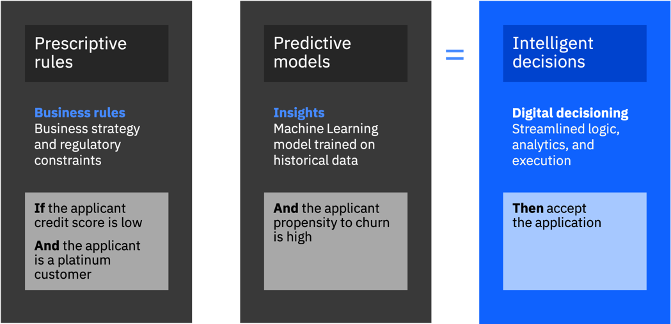
Make predictive decisions
Built-in integration of business rules and machine learning
Directly access machine learning models in a low-code environment for rapid integration of AI into business rule logic
Pre-integrated with Watson Machine Learning predictive analytics to put powerful AI models right at your fingertips
Extend Watson AI capabilities with an extensive framework for third-party machine learning providers
Leverage historical data with AI and improve decision outcomes
Notes:
Now let’s look at how we combine predictive analytics with business rules to automate predictive decisions that can greatly improve outcomes. We’ll look at how this works in a few minutes when we walk through a scenario.
We have a native integration in our decision management solution with Watson Machine Learning. And for those who need it we have a framework for integrating with third-party machine learning providers.

Slide 25
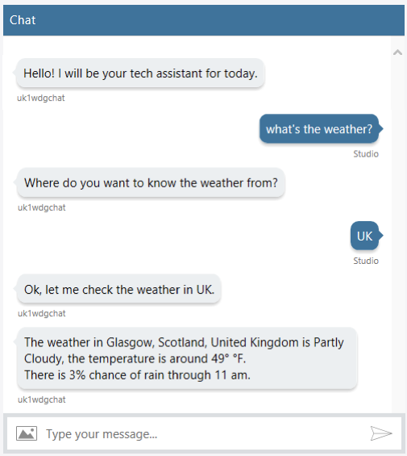
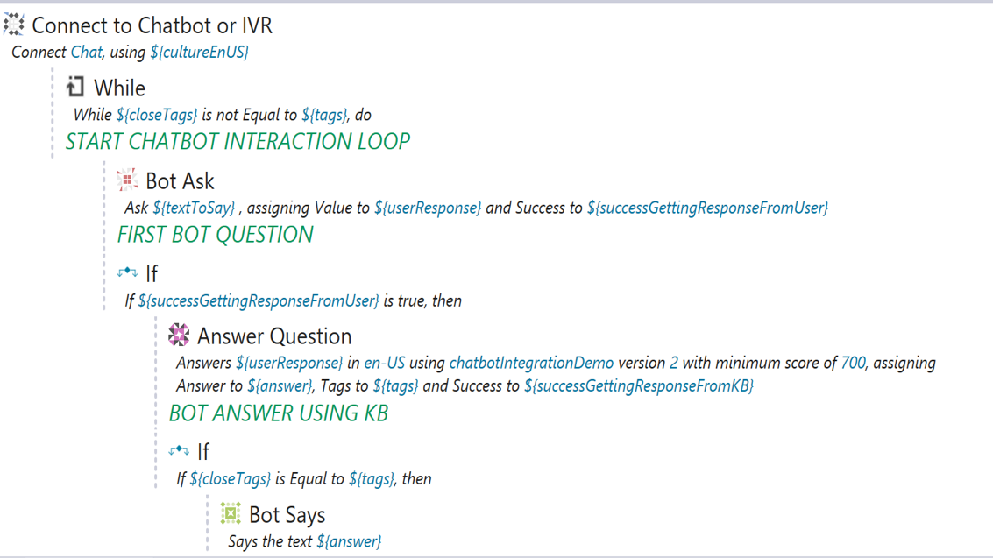
Build intelligent chatbots
Chatbots for intelligent virtual agent (IVA) and interactive voice response (IVR)
Built-in RPA chatbot commands
Train chatbot using a knowledge base
IVR for voice synthesis and recognition
Combine chatbot and other RPA commands to provide engaging client interactions
Simplified chatbot authoring with full knowledgebase support
Intelligent virtual agent (IVA) chatbots used to interact with customers and pass inputs directly to bots
Provide a new customer experience with in-context conversations
Notes:
Now let’s talk about intelligent chatbots.
We provide support for chatbots and interactive voice response that is directly and tightly connected with your automation. This isn’t the type of chatbot that asks, “What can I help you with today?” It’s a very targeted chatbot and/or interactive voice response that uses a conversational style to get the specific data needed by your business operations and to perform specific automated interactions.

Slide 26
IBM Business Automation in action – Refund approvals scenario Achieving 80% straight-through processing
Notes:
Now let’s look at how our Business Automation works in action.

Slide 27

Refund approvals scenario
1
2
3
Gather info
Approve
Issue refund
Customer submits refund request
Customer did not receive retail delivery and asks for a refund
Determine refund approval
Make decision whether to issue refund
Make adjustment and notify customer
Issue refund (if approved), notify customer and close request
Current metrics: 0% straight-through processing (every refund request requires at least some human handling)
Challenge: Get to 80% straight-through processing
Notes:
We’ll look at a refund approval scenario:
A customer orders a product online that never showed up. Several days after the order was supposed to have been delivered, they fill out an online form to request a refund. In certain cases, they must attach a copy of the invoice. The vendor makes a refund approval decision and, assuming it’s approved, notifies the customer and issues the refund.
In the current process, all refund requests are handled by humans at some point in the process. Therefore, there is no straight-through processing.
The goal: To handle 80% of valid refund requests with no human interaction – which means we would have 80% straight-through-processing.

Slide 28
Drive straight-through processing with business automation
Refund approvals scenario
Current process:
Core automation
Step 1 - Add:
Robotic process automation
Step 2 - Add:
Document processing
Step 3 - Add:
Intelligent chatbots
Step 4 - Add:
Predictive decisions
Refund metrics
7 days
4 days
80%
3 days
60%
50%
2 days
0%
30%
1 day
Straight-through processing
Completion time
Straight-through processing
Completion time
Straight-through processing
Completion time
Straight-through processing
Completion time
Straight-through processing
Completion time
Notes:
First, let’s look at the current process. First, a customer submits a refund request which arrives in a general ‘customer support’ inbox, opened by a human who determines the priority, enters data into systems and routes the request accordingly. Next, a decision service evaluates the request on timeframe, loyalty status, amount and other data to determine the approval flow through people and systems which can be inconsistent depending on the people involved. Last, all refund information is entered into the billing system before an email is sent.
[CLICK]
Now let’s see what happens if Robotic Process Automation (RPA) bots are added for accounting (entering data into the billing system) and customer support (selecting and filling out emails by template) to automatically issue the refund. Because bots can complete these previously manual tasks in seconds, updating the use case with these bots:
Improves straight-through processing from 0% to 30%
Reduces the average time from request to refund from 7 days down to 4
[CLICK]
Next, content analysis is added to automatically process incoming documents such as invoices attached with the customer submission. Because the company grew through acquisition, disparate invoice formats exist and automating this step was never possible, but now a new document processing system is able to classify incoming documents of various layouts and extracts the required data using machine learning to understand and learn about new labels and fields over time. By automatically capturing invoice data for refund requests that have an attached invoice, we can:
Increase straight-through processing from 30% to 50%
Reduce average processing time from 4 days to 3
[CLICK]
The company further improves customer service by implementing an intelligent refund chatbot with built-in natural language processing and AI to understand customer input, score confidence levels for each intent and learn over time. The chatbot also uses native RPA commands to query the company’s systems during conversation to validate and gather the required data and create the refund request in the workflow system, eliminating manual data entry. By providing automated real-time assistance to customers who have questions or need help, we can:
Increase straight-through processing from 50% to 60%
Reduce average processing time from 3 days to 2
[CLICK]
Finally, additional decision types can be more fully automated to maximize profitability by keeping its profitable customers happy through understanding risk and predicting each customer’s propensity to churn. By combining decision services with machine learning based predictive analytics (for the customer’s propensity to churn and future lifetime revenue), the company adjusts their refund decisions to be more while at the same time providing significantly better and faster customer service, including:
Reduce average time from request to refund to less than a day
Increase straight-through-processing from 60% to 80%, achieving our goal of 80% straight-through processing.

Slide 29


IBM Cloud Pak for Business Automation
Client and partner solutions
Low-code applications
Automation
accelerators
Process mining and modeling
RPA and digital labor
Operational intelligence
Core automation
Document processing
Workflow automation
Decision management
Content services
AI and machine learning
Automation foundation
Robotic Process Automation
Natural language interactions
Process and task mining
Event detection
Machine learning
3rd party integrations
Operational models
IBM Cloud
AWS
Microsoft Azure
Google Cloud
VMware
Private
IBM Z IBM LinuxOne IBM Power Systems
End points
© 2021 IBM Corporation
29
Notes:
The Cloud Pak for Business Automation is a modular, integrated platform that enables clients to start small and scale.
At the center of the Cloud Pak for Business Automation are core automation capabilities
Document processing: Extraction of data from unstructured paper or electronic documents
Workflow: Getting work done through a sequence of steps that are performed by humans and systems
Decision management: Using rules and policies to automate repeatable decisions that would otherwise need to be made manually
Content services: Management of unstructured or semi-structured documents, text, images, audio or video
Above in the diagram, automation accelerators are added that let clients take advantage of emerging areas and enhance IBM’s core business automation capabilities.
Process mining and modeling: Automatically discovering and graphically representing a company’s business automation to document, analyze and improve how the company operates
Robotic Process Automation (RPA): bots are used to automate repetitive activities
Operational intelligence: Provides insights into business operations by capturing events generated by operational systems. The data is presented in dashboards and made available to data scientists for analysis using AI and machine learning.
Clients use all of these intelligent automation capabilities to build low-code and no-code applications and other client and partner solutions, for example:
Low-code application development: A visual approach to building applications using drag-and-drop components, enabling business users and developers to create applications with minimal code
No-code productivity applications: Automate internal processes, such as approvals, with no technical skills or ramp-up required
The automation foundation provides a core set of platform services that support multiple Cloud Paks. This platform can be flexibly deployed on any cloud, on premises or in a hybrid cloud environment.

Slide 30




Increase velocity and reduce costs with SaaS
Get automation applications up and running quickly
No need to build out IT infrastructure
Host software in our data centers or use containers to deploy on any cloud
Rapidly prototype new automation applications
Spend less upfront and decrease total cost of ownership
Lower data center costs and resources (e.g., space, personnel, power, maintenance, backup, security)
Convert capital expenditures to operating expenditures
Offload software management (e.g., security patches, software updates, compliance management)
We host your automation platform
Over 12 high-bandwidth, low latency data centers in 11 countries on 4 continents to meet data residency and throughput requirements
Focus your IT efforts on business applications rather than infrastructure and platforms
Scale up and down as needed
Easily add capacity to meet spikes in demand
Use flexible pricing models to only pay for what you need
Reallocate subscriptions to other automation platform capabilities with no new contracts
Notes:
Are you ready to adopt IBM Business Automation worry about how long it will take to get started and scale across your business? Capital expenses a concern for your organization?
IBM has Cloud Pak for Business Automation as a Service: a SaaS offering to provide velocity and reduce costs. IBM will get you up and running in hours without the need for you to build infrastructure and host software. Get ready to rapidly prototype new automation applications without delay.
Not only does SaaS increase velocity but the total cost of ownership over time will be lower while IBM maintains data center costs and resources. Infrastructure and software maintenance included. Backup and recovery included. High security standards included.
If you have the need to scale up or down quickly based on workload demands or spikes from periodic and market changes, IBM can easily shift capacity and use flexible pricing models so you only pay for what you need and use. Your team can even reallocate licenses from one business automation capability to another with no new contracts.
IBM has data centers all over the world where we can host your automation platform in 11 countries and on four continents.

Slide 31
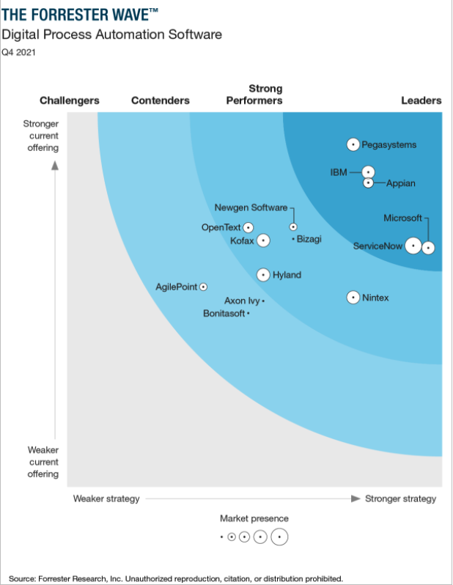
IBM Cloud Pak for Business Automation named a leader
IBM is a leader
The Forrester Wave™: Digital Process Automation Software, Q4 2021 names IBM Cloud Pak for Business Automation a technology leader
The Forrester Wave™ is copyrighted by Forrester Research, Inc. Forrester and Forrester Wave™ are trademarks of Forrester Research, Inc. The Forrester Wave™ is a graphical representation of Forrester’s call on a market and is plotted using a detailed spreadsheet with exposed scores, weightings, and comments. Forrester does not endorse any vendor, product, or service depicted in the Forrester Wave™. Information is based on best available resources. Opinions reflect judgment at the time and are subject to change.
Notes:
This information on this slide comes from the most recent Forrester workflow specific analyst report which you can read at https://reprints2.forrester.com/#/assets/2/73/RES176608/report.

Slide 32

Why IBM Business Automation?
1
Market leading platform Core automation capabilities recognized as market leading technologies all available from one integrated platform
Decades of experience Buy with confidence knowing that IBM has helped thousands of clients achieve improved business performance
Comprehensive capabilities The only integrated platform that provides full end-to-end automation services
Use what you need, when you need Rapidly access the automation services as needed through the most flexible licensing/subscription model in the industry
Supports your hybrid cloud strategy Built on Red Hat OpenShift enabling an open and managed hybrid cloud strategy
Intelligent automation ready Augment your existing automation services with AI through built in integration and connectors
2
3
4
5
6
Notes:
So hopefully by now you are sold on the advantages and power that business automation can bring to you and your enterprise. The question becomes who should you trust to help you on this amazing journey. There are many reasons why IBM should be your partner of choice for business automation.
First, don't take our word for it. The major industry analysts have acknowledged IBM as a leader in virtually every category of the business automation space. The two key reasons that they cite IBM's leadership are 1) our decades of experience helping thousands of clients improve their business performance and 2) the comprehensive capabilities that we have built into our platform as a result of this experience. We also make it as easy as possible for you to buy, consume and reallocate capacity across the various capabilities of our platform, helping to ensure that you don't buy more capacity than you currently need.
The final two reasons that you should partner with IBM for business automation relate to advantages that only IBM can provide. We are the leader in open platform, hybrid cloud capabilities and have leveraged this important characteristic in our business automation platform, allowing you to more easily deploy our capabilities as compared with traditional software implementations. Lastly, and most importantly, IBM is a recognized leader in artificial intelligence, and we continually add more AI capability to our business automation platform to help you build more powerful Business automation solutions and exceed your business performance objectives.

Slide 33
Thank you
First Lastname
Job Title
—
firstlastname@us.ibm.com
+1-555-666-5555
ibm.com
© Copyright IBM Corporation 2021. All rights reserved. The information contained in these materials is provided for informational purposes only, and is provided AS IS without warranty of any kind, express or implied. Any statement of direction represents IBM’s current intent, is subject to change or withdrawal, and represent only goals and objectives. IBM, the IBM logo, IBM Cloud and ibm.com are trademarks of IBM Corp., registered in many jurisdictions worldwide. Other product and service names might be trademarks of IBM or other companies. A current list of IBM trademarks is available at Copyright and trademark information.
Notes:
Thank you.

Slide 35
Alternative detailed slides
Notes:
This presentation will help you understand the value of IBM’s Cloud Pak for Business Automation. The presentation focuses on how businesses have adjusted their digital strategies over the past year and how IBM can help clients better compete during these “unusual” times with a focus on automation.

Slide 36
IBM Business Automation in action – Refund approvals scenario Achieving 80% straight-through processing
Notes:
Now let’s look at how our Business Automation works in action.

Slide 37
Refund approvals scenario
1
2
3
Gather info
Approve
Issue refund
Customer submits refund request
Customer did not receive retail delivery and asks for a refund
Determine refund approval
Make decision whether to issue refund
Make adjustment and notify customer
Issue refund (if approved), notify customer and close request
Current metrics: 0% straight-through processing (every refund request requires at least some human handling)
Challenge: Get to 80% straight-through processing
Notes:
We’ll look at a refund approval scenario:
A customer orders a product online that never showed up. Several days after the order was supposed to have been delivered she fills out an online form to request a refund. In certain cases she has to attach a copy of her invoice. The vendor makes a refund approval decision and, assuming it’s approved, notifies the customer and issues the refund.
In the current process, all refund requests are handled by humans at some point in the process. Therefore there is no straight-through processing.
The goal: To handle 80% of valid refund requests with no human interaction – which means we would have 80% straight-through-processing.

Slide 38
Current situation: Core automation combined with manual work
Refund approvals scenario
Current process:
Core automation
1
2
3
Gather info
Approve
Issue refund
Refund metrics
Initiate workflow Customer fills out web form and attaches documentation
Store documents in repository Customer documentation is stored in content repository
Manually process documents Clerk copies data from attachments into refund system
Assist customers via telephone and email CSRs help customers as needed
Automate business rules Basic decision services are used to make refund determinations
Assign specialists to work with repeat customers Work with customers to ensure customer retention
Manually issue refund Accounts payable clerk copies and pastes refund data into billing system
7 days
0%
Straight-through processing
Completion time
Manual work
Core automation
Notes:
Let’s look at the current process. We’ve color coded the slide with manual activities in red and core automation in blue.
Step one: A customer submits a refund request on the company’s website and in some cases is instructed to include a copy of their receipt. All refund requests, along with many other types of customer support emails, arrive in a general ‘customer support’ inbox. A team of clerks monitors the inbox, opening each email, determining its priority and routing it to the right place for action. For refund requests that requires a copy of the invoice, the clerks manually enters invoice information into the company’s workflow application it uses to process refund requests.
Step two: A decision service evaluates the request. The decision service uses two sets of business rules: One to validate the timeframe; the other to determine if a refund is simple enough to be automatically approved. The rules are as follows:
The ‘timeframe rules’ validate that the refund request is being made AFTER the item should have been delivered and BEFORE the end of the refund window.
The ‘eligibility rules’ determines whether the refund can be automatically approved. All customers with loyalty status are automatically approved for refunds under $100. Customers who are gold or above are approved for refunds under $500; customers platinum and above are approved for refunds under $750. All refunds over $750 must be reviewed by an adjuster.
Clerks manually evaluate any refund requests that fall outside these conditions. Manual decisions are inconsistent, which causes headaches for both the company and its customers.
Step three: For all approved refunds, clerks manually enter refund information into the billing system. They also send the customer an approval email and update the customer record that tracks the refund status. These are time-consuming and error-prone tasks that can lead to significant delays when the volume of refund requests is high.

Slide 39
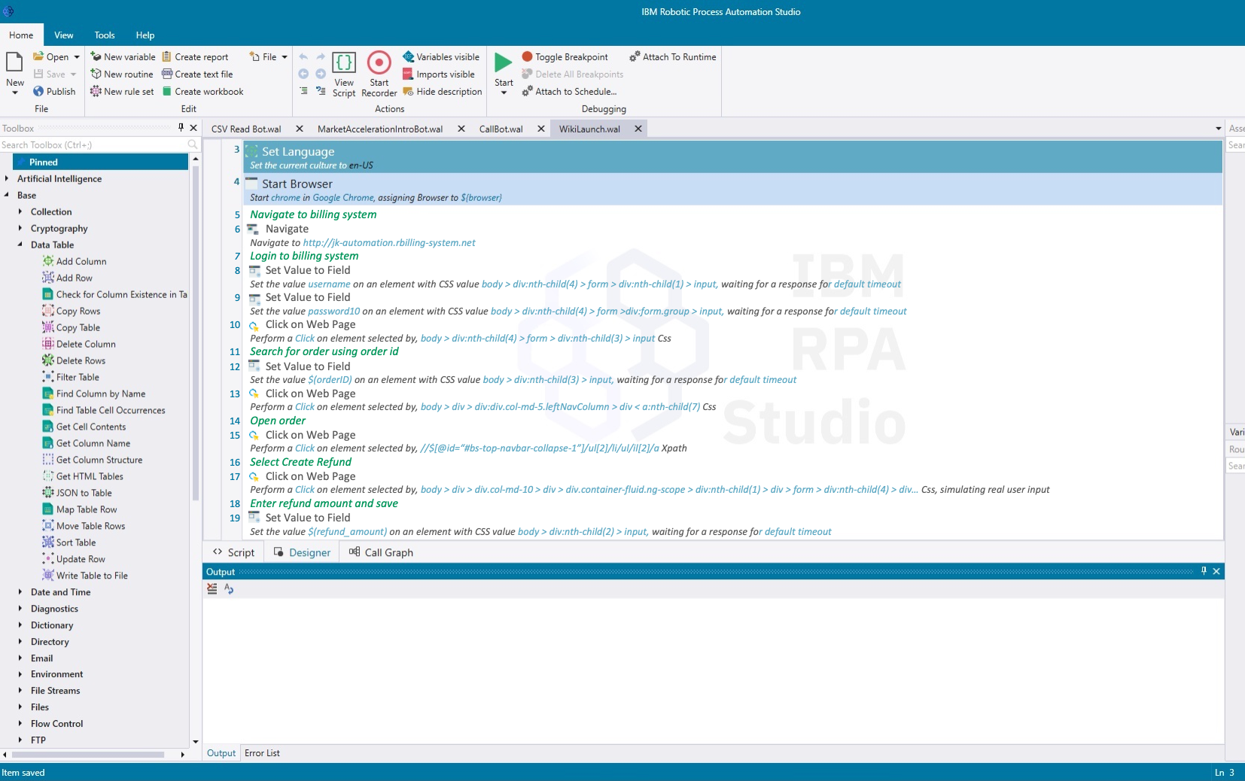
Add robotic process automation to automatically process refunds
Refund approvals scenario
Add:
Robotic process automation
Refund metrics
Placeholder
4 days
30%
Straight-through processing
Completion time
Automatically issue refund RPA automatically replays the billing system actions normally performed manually by an end user. No technical integration is required.
Notes:
Now let’s look at how we can improve the process by adding RPA to automatically issue the refund. The company has built two ‘bots’ that reproduce the work done by clerks in the accounting and customer support departments:
The refund processing bot mimics the actions of an accounting clerk by interacting with the billing system to input the information required to initiate the refund and submit it to the payment processing tool.
The customer update bot mimics the actions of a customer support clerk by selecting the correct email template, copying and pasting customer and account information into the email, and pressing send. The bot then automatically updates the customer record to finish documenting the case.
Because bots can complete these tasks in seconds and use workload management to avoid backlogs, updating the use case with these bots:
Improves straight-through processing from 0% to 30%
Reduces the average time from request to refund from 7 days down to 4

Slide 40
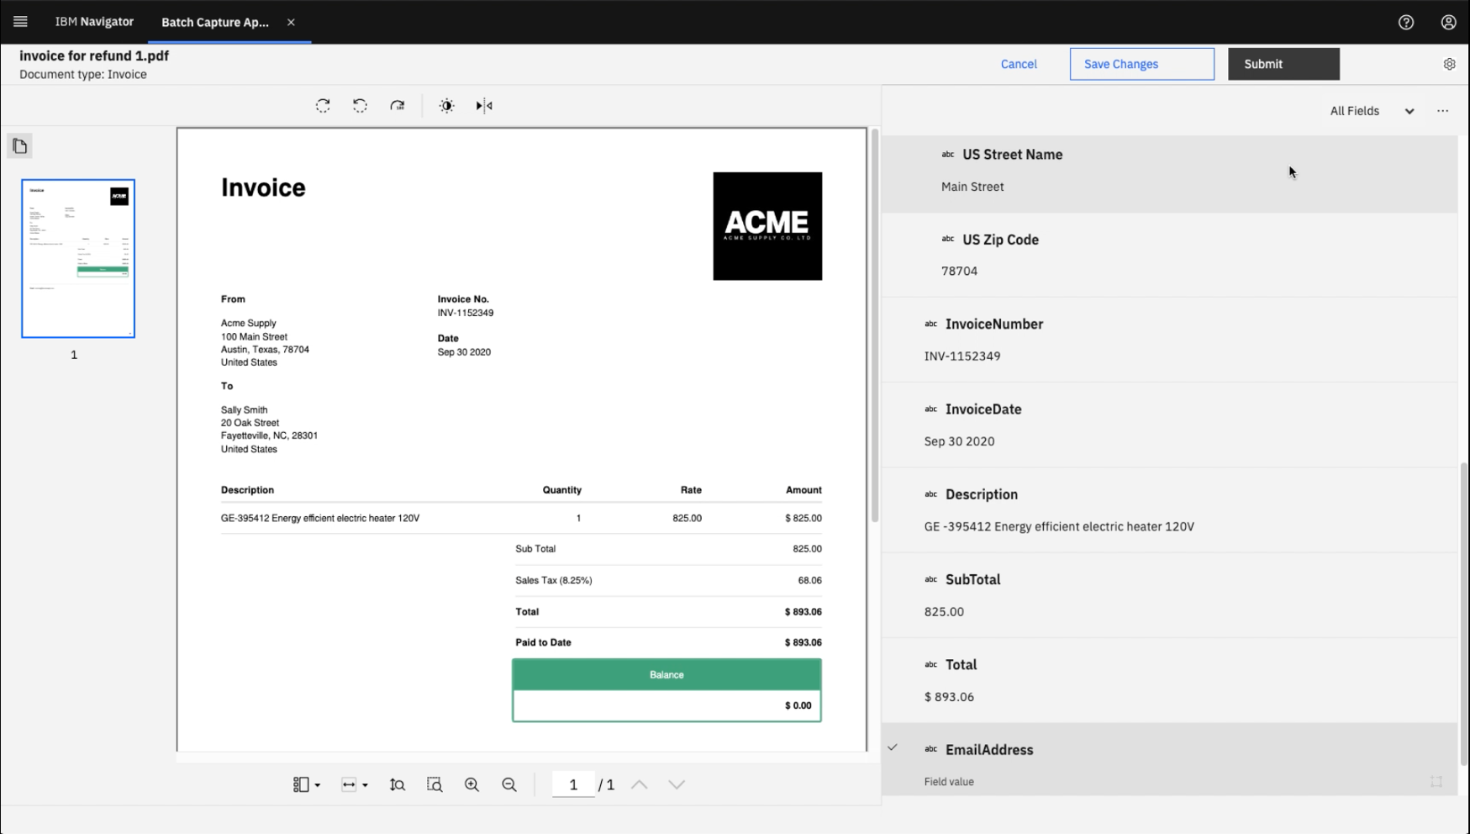
Add document processing to automatically capture unstructured data
Refund approvals scenario
Add:
Document processing
Refund metrics
50%
3 days
Straight-through processing
Completion time
Automatically analyze incoming documents Intelligent document processing automatically finds the customer number and refund amount on the invoice and passes them to the new process
Notes:
Next, we’ll use content analysis to automatically process incoming documents related to the refund request.
For certain refund requests, customers are instructed to attach a copy of their invoice. Because the company grew through acquisition, orders are still taken and fulfilled using disparate invoice formats. Automating this step is challenging due to the need to understand incoming order attachments with a variety of layouts and field names.
Content analysis uses the incoming document’s layout and the data it contains to classify the document. It then extracts data, such as the customer name and address, order number and order amount, even when the field labels vary across invoices.
Document capture uses machine learning to understand different document layouts. It can also learn over time to interpret variations of text labels that have the same meaning. For example, it can learn that some invoices use ‘order number’ while others use ‘order ID’ to mean the same thing.
By automatically capturing invoice data for refund requests that have an attached invoice, we can:
Increase straight-through processing from 30% to 50%
Reduce average processing time from 4 days to 3

Slide 41
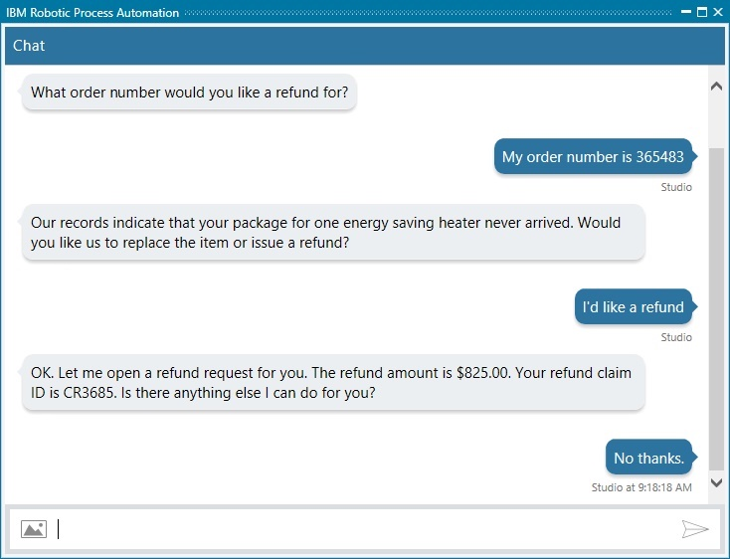
Add intelligent chatbots to interact with customers
Refund approvals scenario
Add:
Intelligent chatbots
Refund metrics
60%
2 days
Straight-through processing
Completion time
Converse with customers via intelligent chatbots Machine learning automatically helps power bots that can handle many types of refunds through text and speech interactions without human intervention
Notes:
The company further improves customer service by implementing an intelligent refund chatbot. The chatbot uses built-in natural language processing and AI to understand customer prompts and respond appropriately. For each customer request, the chatbot uses confidence levels to score how sure it is of the customer’s intent. It also learns over time to improve its natural language understanding. Here’s what a chatbot session might look like:
Chatbot: What order number would you like a refund for?
Customer: My order number is 365483
Chatbot: Our records indicate that your package for one energy saving heater never arrived. Would you like us to replace the item or issue a refund?
Customer: I’d like a refund
Chatbot: OK. Let me open a refund request for you. The refund amount is $825.00. Your refund claim ID is CR3456. Is there anything else I can do for you?
Customer: No thanks
The chatbot uses RPA commands to query the company’s transaction database to get transaction details. It also queries the company’s delivery system and sees that there is no delivery confirmation from the shipping service, confirming that the customer’s claim of not receiving the shipment is correct. The chatbot creates the refund request in the workflow system, eliminating the need for the customer to fill out a refund request form.
By providing automated real-time assistance to customers who have questions or need help, we can:
Increase straight-through processing from 50% to 60%
Reduce average processing time from 3 days to 2

Slide 42
Add predictive analytics to make more profitable decisions
Refund approvals scenario
Add:
Predictive decisions
Refund metrics
80%
1 day
Straight-through processing
Completion time
Apply predictive decisions Predictive analytics, such as customer propensity to churn, helps the business be proactive in addressing complex challenges
Notes:
Finally, let’s look at what types of decisions can be more fully automated. The company’s goal is to maximize profitability. Keeping its profitable customers happy can contribute significantly to that goal. So what if we could assess each customer’s profitability, understand the risk of quickly approving a refund, and predict each customer’s propensity to churn? We can, by combining decision services with predictive analytics to make predictive decisions.
Predictive decisions allow organizations to use probabilities to forecast the propensity of valuable customers to leave. This enables companies to widen the conditions under which they approve refunds for those customers.
In our predictive decisions example we’ll use two predictive models to improve our refund decision service. The first estimates the customer’s propensity to churn. The second estimates the customer’s future lifetime revenues, as follows:
The ‘propensity to churn’ service is trained with customer data from our operational intelligence capability. We’ll use data such as the customer’s age, loyalty status, number of years they have been a customer, lifetime value of purchases and total number of purchases. The machine learning model can then estimate the propensity of an existing customer to leave in the case of a refund denial. That will enable us to expand our rules for this customer to try harder to keep their business. We don’t want to loosen our rules for all customers, but it’s to our advantage to be more flexible when we can predict that the customer has a higher propensity to churn.
The ‘lifetime value prediction’ service trains a machine learning model to estimate the lifetime value of this customer. The machine learning model collects the customer’s past transaction data and correlates it to other customers’ data with similar purchase patterns. The model then assigns probabilities that future profits from this customer will be within certain ranges. For example, the model’s output might predict the company’s future profits from this customer have a 60% chance of being greater than $2,000, a 40% chance of being greater than $4,000, and a 25% chance of being greater than $6,000.
With these two machine learning services, the company can make more profitable refund decisions that understand the entire customer context, while at the same time providing significantly better and faster customer service.
Because predictive analytics can make more nuanced decisions based on actual profitability factors, we now make more automated decisions that can:
Reduce average time from request to refund to less than a day
Increase straight-through-processing from 60% to 80%, achieving our goal of 80% straight-through processing.

Slide 43
Capability of IBM Business Automation – Core automation
Notes:
Now let’s look at how our Business Automation works in action.

Slide 44



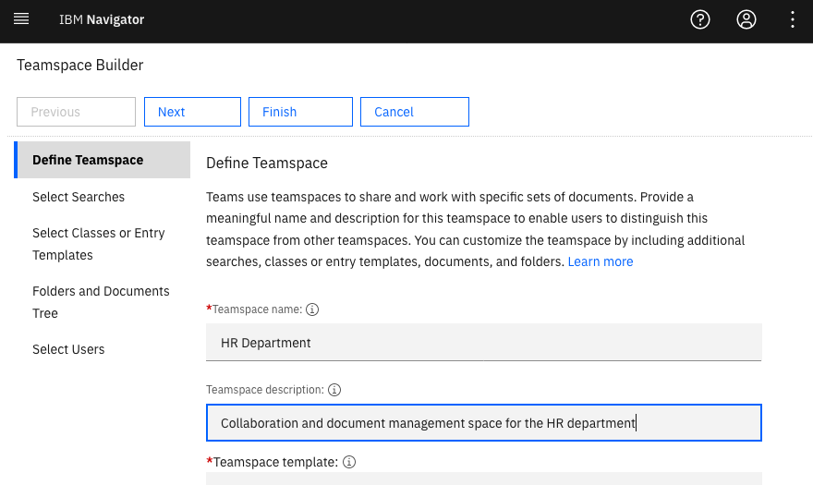

Digitize content
Content management
Store and manage business content
Powerful search capabilities
Federation across repositories
Security and privacy
Rich granular security controls
Role-based redaction
Collaboration
Collaboration, content synchronization and sharing, and mobile support
Securely share documents and folders with external users
Governance and lifecycle management
Information governance for cross-organizational data retention
Lifecycle and records management
Content is unstructured or semi-structured information including documents, text, images, audio and video. Content services enable users to securely manage the full lifecycle of content.
IBM provides flexible, reliable and secure content services delivered in modern lightweight architecture.
Notes:
Content is unstructured or semi-structured information that can include documents, text, images, audio and video.
Content services enable users to securely manage the full lifecycle of content.
We have an enterprise-class content solution that provides flexible, reliable and secure content services. We have powerful search capabilities and enable federation across content repositories. We provide enterprise-grade security, privacy, information governance and records management. And in addition to sharing content within a company, we also enable secure sharing of content with external users who are outside the organization.

Slide 45

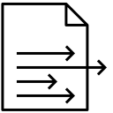
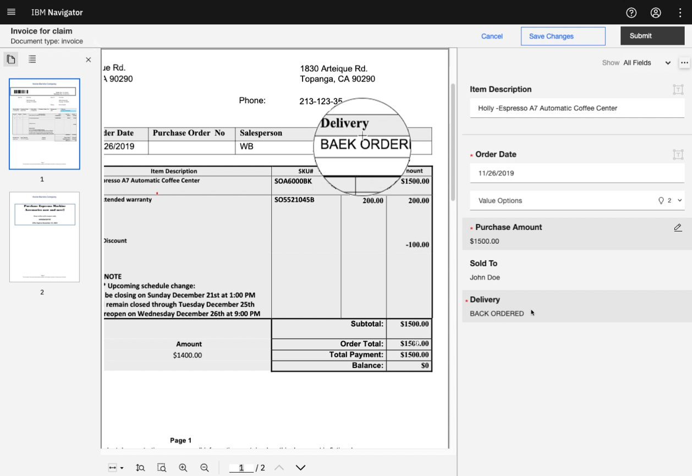

Capture and process documents
Acquisition
Multi-channel document acquisition
Sources include scanner, fax, email, mobile, file system, content repository
Extraction
Classify and extract data from documents and images
Machine learning and AI tools
Sophisticated rules to validate data
End-to-end solution
Build flexible and customizable capture applications
Manage capture workflow
High availability and enterprise- grade reliability, security, and disaster recovery
Document processing is the ability to import unstructured paper or electronic documents and extract data through recognition, classification and artificial intelligence.
IBM uses a combination of Watson analytics, advanced imaging and machine learning to understand documents.
Notes:
Capture is the ability to import unstructured paper or electronic documents and extract data through recognition, classification and artificial intelligence.
We have a complete end-to-end capture solution that enables multi-channel document acquisition from physical and digital sources; sophisticated data validation rules; and offers enterprise-grade reliability, security, and disaster recovery.

Slide 46


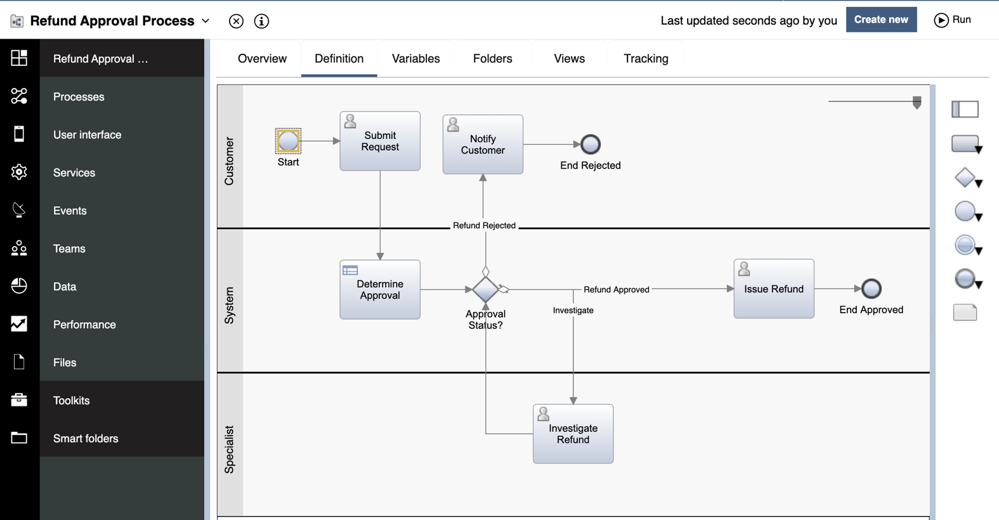
Manage work
Design
Graphical workflow designer
Low-code/ No-code authoring environment
UI builder with rich palette of controls
Reuse common components
Execution and monitoring
360° view of workflow instances, activities and content
Flexible search and filtering
Responsive, mobile ready UI
Real time process and case metrics
Governance and lifecycle management
Centrally managed development
Built-in versioning and “one-click deployment”
Manage hundreds of process applications across the enterprise
Available fit-for-purpose application scaling
Workflow defines how work gets done through a sequence of steps performed collaboratively between humans and systems. Workflow management is the design, execution, and monitoring of workflows.
IBM enables both process and case owners to engage directly in workflow implementation
Notes:
Workflow defines how work gets done through a sequence of steps performed by humans and systems.
Workflow management is the design, execution and monitoring of workflows.
Our solution enables business users and process owners to engage directly in implementation, with a graphical workflow designer, a low-code design environment and a user interface builder that includes a rich palette of UI controls. To support world-class runtime and monitoring we enable consolidated task management, flexible search and filtering, and real-time process metrics. Our workflow capability has strong governance and lifecycle management, including centrally managed development, built-in versioning and the ability to deploy a process with a single click - all within an enterprise-class, highly secure and fully governed environment.

Slide 47

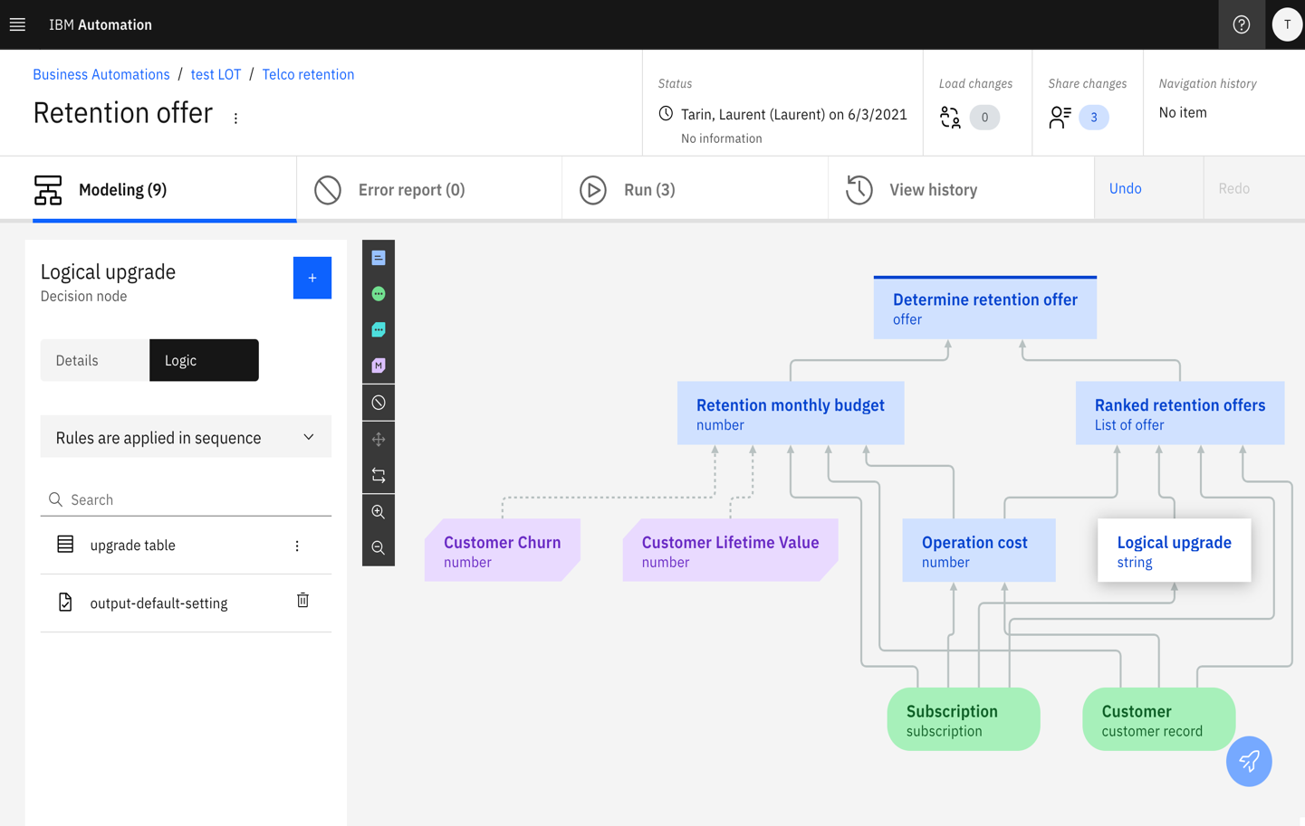
Automate decisions
Define
No-code decision modeling
Graphical guided tools to model and validate decisions
Integrates business rules with machine learning
Execution and testing
Test and simulate decisions
Execute decisions with speed and consistency
Highly scalable micro services architecture
Execution tracing for auditability
Governance and lifecycle management
Release management and versioning
Role-based permission management
Decisions are the repeatable rules and policies made as part of business operations. Decision management is the software used to gather, manage, execute and monitor decisions.
IBM provides comprehensive lifecycle management for development, testing and governance of business rules.
Notes:
Decisions are the repeatable rules and policies made as part of day-to-day business operations.
Decision management refers to the software used to gather, manage, execute and monitor decisions.
Our solution includes business-friendly capabilities for development, testing and governance of decision services, and a comprehensive framework for business rules lifecycle management. We provide no-code decision modeling and graphical guided tools to validate decisions. We have a world-class, high-performance execution and testing environment… with a highly scalable micro services architecture, and full simulation and auditability.

Slide 48

Build low-code applications
Build
Low-code application builder
UI builder with rich palette of controls
Drag and drop automation components for workflow, decisions and content
Collaboration and reuse
Toolkits and templates are created by developers and used by business users to assemble applications
Components can be reused across applications
Governance and lifecycle management
Test applications
Create new versions
Publish for deployment
Low-code application development is a visual approach to building applications using drag-and-drop components. Low-code tools enable business users and developers to create applications without having to write code.
IBM provides ability to create and deliver automation applications in a fraction of the time it takes with traditional methods
Notes:
Cloud Pak for Business Automation provides a no code editor allowing you to rapidly create, test and deploy business applications.
Business Automation Studio comes with a set of predefined skills to also create content or decisions services as well.
You can rapidly use these services within the business applications you are creating in Application designer and then rapidly deliver new automation solutions .

Slide 49
Expert Lab Services
Notes:
Now let’s look at how our Business Automation works in action.

Slide 50
Deploy a “quick win” project in 6 weeks
Greg: as of 1/10/22 at 10:22am PT, connected with Sandeep. He will update slides 51-52 ASAP.
Objective: Execute a focused and fast paced 6-week engagement with Expert Labs
Our approach:
½ day
6 weeks
Solution assess
(No fee)
Architecture workshop
Infrastructure build
Pilot solution build
Close out
Set expectations for 6-week engagement
Provide Cloud Pak functional overview
Review pilot use case options
Discuss pre-reqs and dependencies
Assess readiness to commence
Define pilot use case scope and requirements
Assess risks and mitigation
Create solution architecture and design specifications
Plan for infrastructure and solution build
Install and configure the IBM Cloud Pak for Business Automation on Red Hat® OpenShift® container platform
Develop pilot solution
Test and validate
Deploy on Cloud Pak platform
Demonstrate pilot solution
Hand over deliverables
Notes:
Part # ➔ 1X D02MEZX
IBM Integration Expert Labs will work with your clients to achieve successful business outcomes on IBM Cloud Paks, whether they need expert guidance on modernizing their workloads or to build and prove solutions that seize new opportunities.
Outcomes
Business requirements, use cases, and architecture
Deployment approach and plan
Installed, configured, and validated Cloud Pak environment
Pilot solution built and deployed

Slide 51
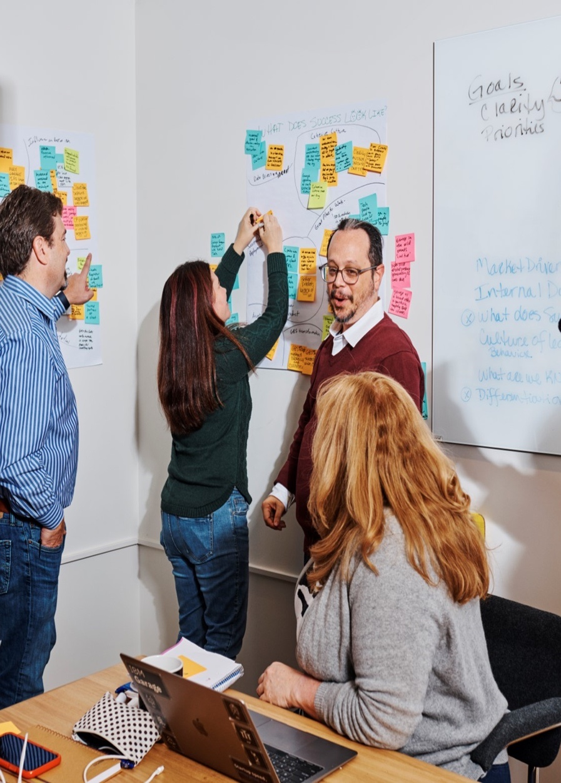
Automation Innovation Workshop
IBM Expert Labs is offering a complimentary half-day workshop to help you identify how AI-powered automation can solve some of your toughest operational challenges.
In this workshop, IBM Automation and Industry subject matter experts will:
Share the latest in AI-powered automation, including an inside look at how industry peers are leveraging automation
Facilitate an interactive design-thinking exercise to discover top pain points and challenges within your organization that automation can solve
Co-create an actionable plan for achieving required business outcomes
79% of executives
whose organizations are scaling intelligent automation expect their organization to outperform the competition in revenue growth within the next three years.
- IBM Institute for Business Value, Automation and the future of work, 2020

